Slide 1
ISSM Day2 worksheet
This activity involves a group discussion.
You are allowed to use AI tools for this discussion.

Slide 2
Team members
List your team members’ full names (as in your course registration)
Wang Mingyang A0331532R
Su Tanjia A0354250M
Fu Junchun A0353395W
Yan Yi A0333825A
Wang Zimo A0328948J

Slide 3
Case study
Use case: An intelligent pipe inspection system
In heavy rain, impervious surfaces such as roads and driveways can contribute a large amount of polluted stormwater. To prevent flooding, streets are usually lined with stormwater drains to move stormwater off the road quickly. These drains are connected to stormwater pipes that channel stormwater directly to a nearby water body.
These stormwater pipes are often monitored to understand the status of the stormwater system, so that the local authority can plan maintenance and future facility development. Currently, these pipes are inspected on-site. A certified technician guides a robot with a camera mounted and visually looks for defects. Once a defect is found, the technician rotates and zooms in the camera manually to get a better understanding of the defect. This process is time-consuming and expensive.
The local authority decided this process should be automated. They came to the start-up you are working in and sought a solution. They are looking at a system to identify five types of common defects in a pipe automatically.

Slide 4
Question
To further enhance the automated robot vision-based inspection solution, your company has decided to deploy a set of IoT sensors to provide continuous pipe monitoring, such as a water flow sensor. Table 1 provides an example of a water flow sensor dataset. These sensor data are updated at an interval of one hour. You are asked to predict the risk of choked drainage using the water flow sensor data. The change in the water flow sensor reading over time might give you some insight. For example, if the pipe is choked, the water flow speed might suddenly decrease to a smaller value. Evaluate whether the Haar wavelet transformation can indicate the pipe choke (i.e., a significant change in the water flow using sensor readings over time) from the water level data provided in Table 1.
Table 1. An example of a water flow sensor dataset used for pipe monitoring. These sensor data are updated at an interval of one hour.
Signal index | 1 | 2 | 3 | 4 | 5 | 6 | 7 | 8
Water flow sensor reading (meter/second) | 0.6 | 0.7 | 0.8 | 0.4 | 0.3 | 0.3 | 0.6 | 0.6

Slide 5
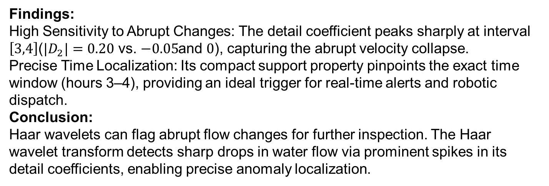
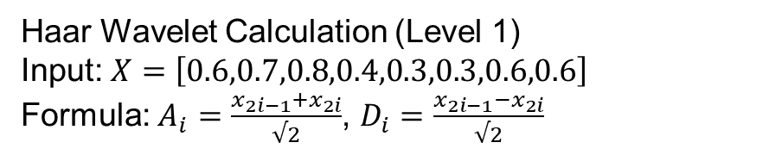
Your answers
Haar Wavelet Calculation (Level 1)
Input: $X=\left[0.6,0.7,0.8,0.4,0.3,0.3,0.6,0.6\right]$
Formula: $A_{i}=\frac{x_{2i−1}+x_{2i}}{√2}$, $D_{i}=\frac{x_{2i−1}−x_{2i}}{√2}$
Interval | Approx | Detail | Status
1-2 | 0.919 | -0.071 | Normal slight rise
3-4 | 0.849 | +0.283 | Sharp drop
5-6 | 0.424 | 0.000 | Low flow
7-8 | 0.849 | 0.000 | Flow restored
Findings:
High Sensitivity to Abrupt Changes: The detail coefficient peaks sharply at interval $\left[3,4\right]$($|D_{2}|=0.20$ vs. $−0.05$and $0$), capturing the abrupt velocity collapse.
Precise Time Localization: Its compact support property pinpoints the exact time window (hours 3–4), providing an ideal trigger for real-time alerts and robotic dispatch.
Conclusion:
Haar wavelets can flag abrupt flow changes for further inspection. The Haar wavelet transform detects sharp drops in water flow via prominent spikes in its detail coefficients, enabling precise anomaly localization.

Slide 6
AI Tool Declaration
[Sample declaration copied from Canvas] The authors didn't use any AI tool. The authors used [AI tool name, e.g., GPT-5.1] to [describe specific uses: e.g., generate ideas, format paragraphs, improve expression, analyse effectiveness, create images and illustrations, produce drafts, refine, and/or finalise my assignment]. The authors are responsible for the content and quality of the submitted work.
The authors used Gemini to translate the English text and provide detailed explanations of the definitions and mathematical formulas of the Haar wavelet transform. The authors are responsible for the content and quality of the submitted work.

